Slide 1
CAPSTONE PROJECT-1
DATA EXPERIMENTATION CAPSTONE
By Ihsan Tolga Medeni, 2022.07.27

Slide 2
CONTENT
Data
Data Science Approach
Data Wrangling/Data Cleaning
EDA-exploring the data
Modelling-A/B testing
Interpretation
Answers to the Problem Question

Slide 3
Data
The data was downloaded from Kaggle.com
I renamed the file as: AdSmartABdata.csv

Slide 4
Columns Details
VariableName | Description
auction_id | the unique id of the online user who has been presented the BIO. In standard terminologies this is called an impression id. The user may see the BIO questionnaire but choose not to respond. In that case both the yes and no columns are zero.
experiment | which group the user belongs to - control or exposed. Control: users who have been shown a dummy ad. Exposed: users who have been shown a creative, an online interactive ad, with the SmartAd brand.
date | the date in YYYY-MM-DD format
hour | the hour of the day in HH format
device_make | the name of the type of device the user has e.g. Samsung
platform_os | the id of the OS the user has.
browser | the name of the browser the user uses to see the BIO questionnaire.
yes | 1 if the user chooses the “Yes” radio button for the BIO questionnaire.
no | 1 if the user chooses the “No” radio button for the BIO questionnaire.

Slide 5
Data Science Approach
In the same web page, I followed, the following link:
https://www.kaggle.com/code/pavelaverin/three-ways-of-doing-a-b-tests
It implements 3 different ways to analyze.
Sampling Distribution
Confidence Interval
Logistic Regression

Slide 6
For this project, I select the implementation of Sampling distribution under the null, which is actually z-Test
The following scripts shared under the name of : CapStoneProject01_TolgaMedeni.ipynb

Slide 7
Data Wrangling/ Data Cleaning Exploring the Data
I named the dataframe object as df, which we store the information taken from the .csv file
df = pd.read_csv("AdSmartABdata.csv")

Slide 8
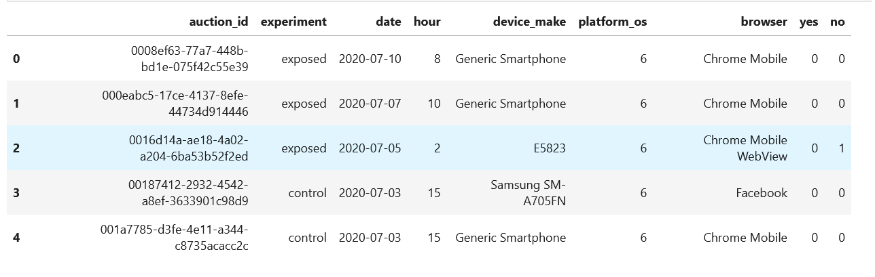
Let me illustrate the steps which I applied for this project
To obtain data properties: df.head(5) was applied

Slide 9
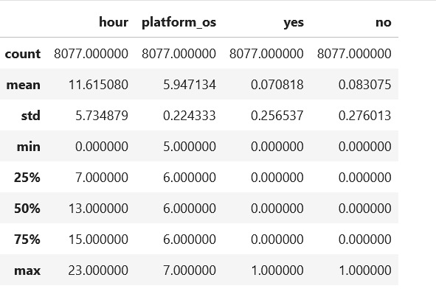
df.describe()

Slide 10
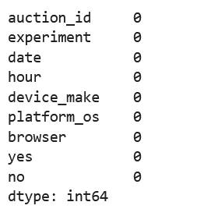
To check data quality (the number of null and duplicated values) I implemented the following scripts:
df.isnull().sum()

Slide 11
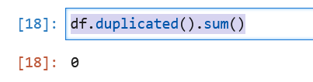
df.duplicated().sum()

Slide 12
As a result, there is no null values and no duplicated values in the data set. We may use it without any extra cleansing activities

Slide 13
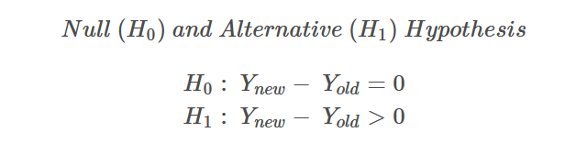
Modeling - A/B testing
The null hypothesis will state that there are no changes in conversion either with the new creative ad or with the dummy ad. The alternative hypothesis is the conversion rate is higher with the new creative ad than with the dummy one.
The alpha is 5%. That means we will reject the null hypothesis only when the probability of observing the difference in sample proportion given the null hypothesis is true is less than 5%.
In the given analysis, one tailed hypothesis test was implemented, in this project, I will apply the same

Slide 14
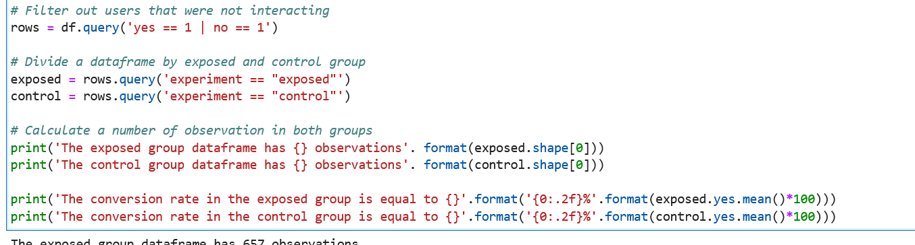
The following script gives us the ad exposed and control groups in the given sample.

Slide 15
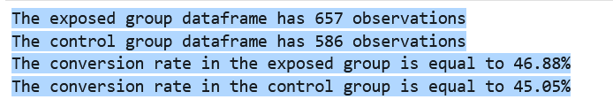
The result of the previous script is:

Slide 16
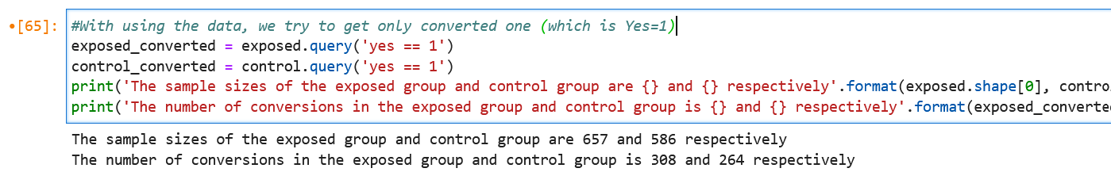
And to get only converged ones in this set the following code is implemented:

Slide 17
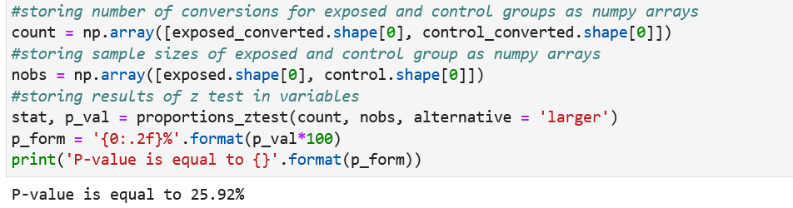
To calculate the p-value, the following script was implemented:

Slide 18
Interpretation
As you can see, we get a value more than 5% which means,
#H0, the null hypothesis can not be rejected. Conversion expectation is a failure. There are no changes in conversion either with the new add or with the dummy add, because the value is greater than 5%
#Because we are working on categorical values, this result was created based on a binominal distribution. It is required to convert it into normal distribution, in order to apply t-test. To do that, with using this 8077 records, we have created 250000 numbered sample (In the original example, 100000 was implemented)

Slide 19
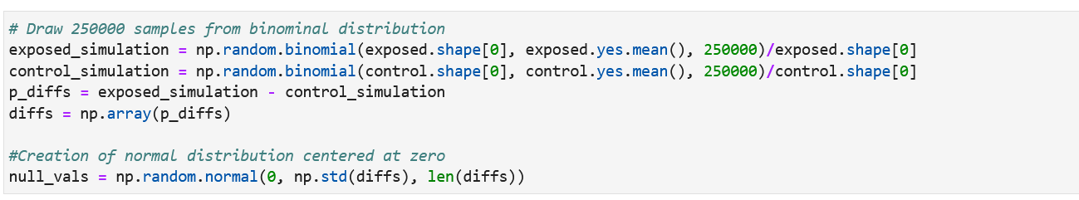

Slide 20
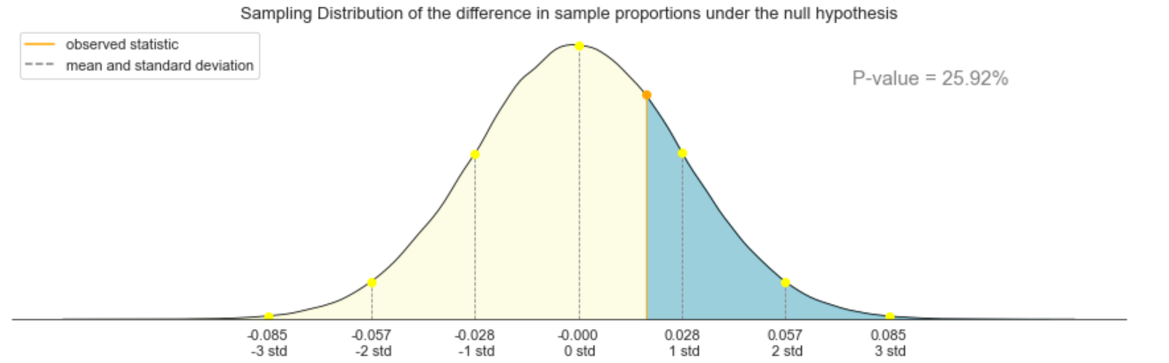
In here, with updating the given one tailed normal distribution graph, we were created the following figure

Slide 21
Our interpretation from the graph as follows;
#We implemented a normal distribution via binomial distribution. When the observed part is orange, the test shows the given figure. This observed value, stays in the middle of the +- 1 standard diversion.
#The observations shows lower diversion with respect to mean and standard deviation. For this reason, H0 is accepted. And this result is correlated with the p-value.

Slide 22
Answers to the Problem Question
Does the new ad generate more responses to their questionnaire?
There is no significant evidence, new ad had a positive effect on the responses. (p-value is greater than 0.05 so we accept the null hypothesis,
Is it statistically significant?
Because of this result, this is insignificant
Is the company justified in using the new ad?
The company can not justify the usage of the new ad, based on this results.

Slide 23
Future Work
However, as we can see the cv file, there are other potential result could be obtained, such as, if we cluster the results based on the user devices, the ad could affect in a specific type of user group. In the future, this study could be focused on to the specific device users.

